Slide 1
Visualizing Text
David Ferris – CS 460 – 5/1/14

Slide 2
Project Definition and Requirements
“Develop an application that represents complex data sets in visual and understandable ways.”
Requirements
Large data sets
Simple visual attributes
Keep application general
Visuals should be click-able
Notes:
The simple description of the goal of the project was to “develop an application that represents complex data sets in visual and understandable ways.”
Some of the requirements for the project were:
Have the project’s generated visuals represent large data sets
Use simple visual attributes to indicate different properties of the data
Keep the application general, so that it can handle different sets of data. The project was intended to handle various types of data input, such as survey responses, news articles, possibly social media content (tweets, Facebook posts)
Open-ended survey responses were the original idea behind the project.
Clicking on the generated visuals should provide more depth on the data

Slide 3
Early Ideas
C++ application
Identify “important” words
Track “important” word use
Create data structures to hold data
Create a webpage to display data
Notes:
I feel very comfortable programming in C++ and it seemed to be a good language for the project solution that I had in mind.
In the earliest stages of the project, I initially wanted to identify “important” words, i.e. words that give the most insight as to the content of the overall text.
In order to have a better idea of how the words were being used, I would need to track the context in which they were used.
Good data structures would need to be created to contain data, and provide easy lookup of words.
Finally, I decided that, based on my skills (what I knew how to do), the best way to create the interactive visual display of the processed data was to create a webpage.

Slide 4
Identifying Sentences and Words
Sentences
Split on sentence-ending characters
Inserted into sentences file
Words
Find individual words from sentence
Don’t modify sentences file
Insert into data structure
Later modifications
Account for titles (Dr., Mr., Mrs., etc.)
Remove suffixes from words
“play”, “playing”, “played”
Leads to some mistakes
Ignore “useless” words
Notes:
Before any data can be inserted into data structures, the data from the input text file needs to be parsed
Split the input text file into sentences
In order to do this, the file is split based on “sentence-ending characters”
These are .!?
Each sentence will then be written to a line of the sentences file.
Split each sentence into words, without modifying the sentences file
Go through a sentence, one char at a time.
A non-alphabetical character signifies the end of a word
Word is then added to the main data structure
Test runs showed that some words would need to be modified before being inserted
Strengthen the quality of the resulting data
Abbreviated titles caused sentence fragmentation
Tell how you resolved this – checking ends of sentences for titles.
Match up “root” words. Different forms of a word appear throughout, we want to be able to match them up
To get the “root” word, we need to remove suffixes from words
Chose to use suffixes such as “-ed”, “-ing”, etc., since they don’t seem to alter the basic meaning of the word
Removing prefixes could change this. EX: “un-” or “re-”
This can sometimes lead to mistakes, such as in the case where the “root” word does not match up with the word after the suffix is dropped
For example, “remove” and “removed”.
There are many words that I consider to be “useless”
Compare word against list of “ignored” words prior to insertion in to data structures
Thanks to Mike Klosiewski 2013 project for the list of ignored words – “excluded” words.

Slide 5
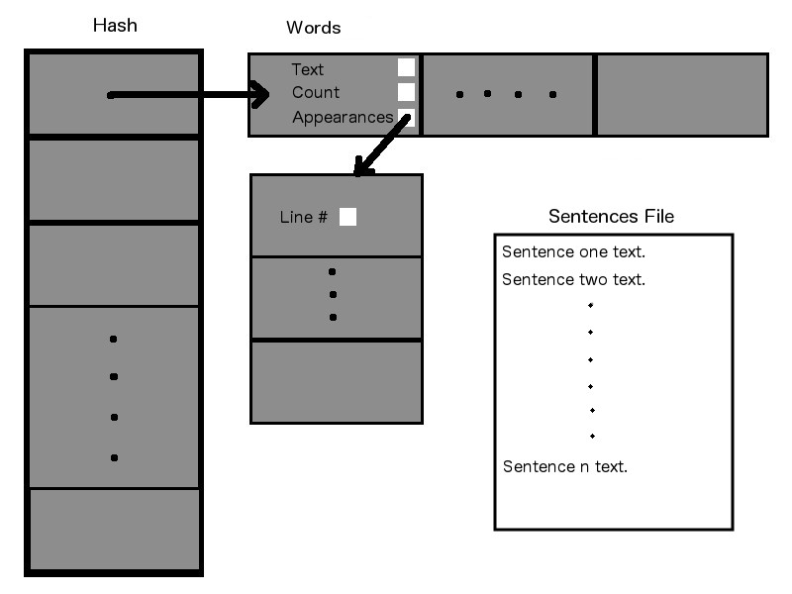
Data Structures
Notes:
This is a drawing of the main data structures used in my C++ application.
The Hash is a hash-table class that I created.
Each index of the Hash points to a dynamic Word array.
Each Word has an “Appearances” pointer, which points to a dynamic integer array of line #s.
These line #s represent lines in the sentences file
The sentences file contains each of the sentences from the original input file, one per line.
Thus, the line #s stored in the various Appearances arrays correspond to sentences in the sentences file
This is how the program tracks the sentences in which each word appears. Each Word essentially has an array listing the numbers of the sentences in which it appears
Collision resolution – add word to the end of array, don’t need to find empty index
The use of dynamic arrays (“chaining”) allows for the hash size to be roughly equal to the expected word count
Estimated word count based on the size of the file (in bytes) and the average length of a word in the English language (in chars).
Using a prime number for the size of the Hash helps to achieve a better distribution of items throughout.
Found the closest prime # >= the estimated word count.

Slide 6
Determining Results
Top Words
QuickSort
O(nlogn) average comparisons
Amount of words sent to file set by global variable
Writing results to file
Top N words
Appearances of top N words
Sentences
Notes:
Determining the “top” words, or the words that occur the most throughout
Use 2 parallel arrays – one with all words – one with appearance counts
Using QuickSort, the words and counts will be sorted in descending order, based upon the counts
QuickSort chosen for it O(nlogn) average runtime. O(nlogn) comparisons to complete sort of n items
A global variable controls the number of “top words” that the user wants to be conveyed to the webpage.
Once the words have been sorted, the results can be written to a text file that will be read by the webpage
The top words (I am using 5) are then written to a text file, along with the contents of their “Appearance” arrays. This way, the webpage will be able to display the words along with the sentences in which they appear.
As of now, all of the sentences from the sentences file are also being written to this new text file. This could also be accomplished by sending the sentences file to the webpage.

Slide 7
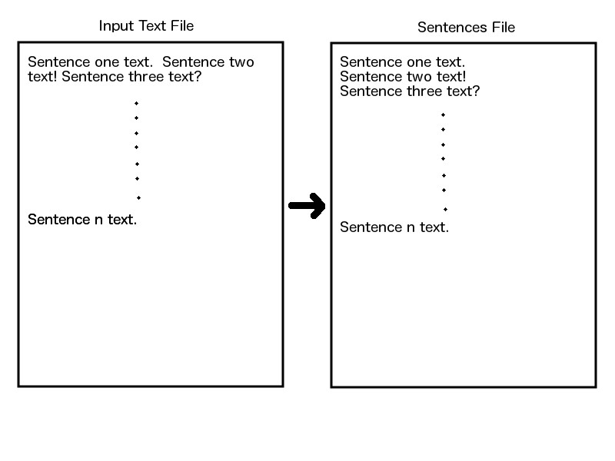
Sentences File Format
Notes:
Now I’d like to run through a quick example with some simple data.
Here is a diagram showing how data from the input file is stored in the sentences file.

Slide 8
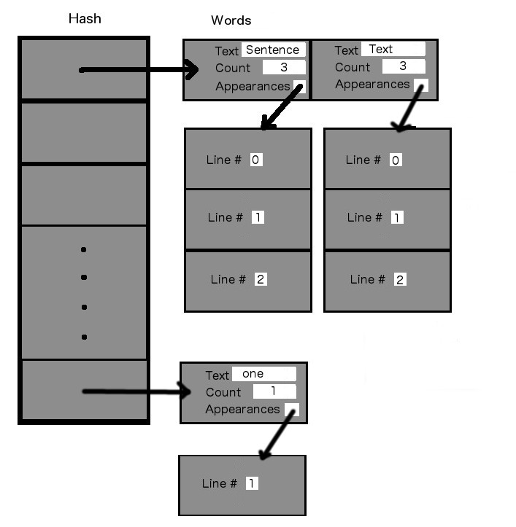
Notes:
This slide shows how data is inserted and stored in the data structures.
I wanted to be able to fit the diagram on the slide, so I didn’t insert all of the words from the text file.
The words left out were “two” and “three”.
Also, be aware that the hash table indices were chosen just to show how the structure works, rather than on actual calculated values.

Slide 9
Visual Generation
Upload text file using FTP client
PHP reads the text file
Uses data to populate page’s structure
Top words are displayed
Size indicates the frequency of use of the word
Click to reveal sentences
Words that appear in > 10 sentences
Notes:
After all of the data has been written to the new text file, an FTP client can be used to upload the file to a PHP-interpreting server where the webpage’s PHP, HTML, CSS, and JavaScript files are stored
The PHP file will then read the data from the text file and store it in arrays.
This data is then inserted into the various divs and headers on the page.
The N top words are displayed along the left side
The size of the words indicate the frequencies of their use. Biggest -> smallest
Each word can be clicked to reveal a maximum of 10 of the sentences in which the word was found
For words that appeared in > 10 sentences, a random sample of 10 appearances is chosen upon page load

Slide 10
Things I Didn’t Accomplish
Incorporation of color into data visualization
Words appearing in > 10 sentences, generate new set upon click
Certain characters not in 0-255 ascii range cause problems
Characters from other languages
Styled punctuation from websites
Notes:
Some things I would have liked to include in the project
Generation of random samples on webpage
Weird characters found in copied text
Fragment sentence

Slide 11
Methodology
Early focus on data structures
Everything else built around these
One new function at a time
Sample input files
Short, typed text files
Often specialized when testing a certain case/feature
Copied articles from web sources
Notes:
Early on in the project, majority of focus was on building good data structures
After data structures were complete, most of the remainder of the project could be build around them
Insertion and retrieval from structures
Manipulating data before it is inserted or after it is retrieved
New functions would then be added one at a time. Kind of component based approach
Testing of the program and structures throughout mostly consisted of short text files
These would usually be tailored to test a certain function of the program, or a strange situation that might arise
Once the program was close to completion, began testing with longer files
Articles copied from various online sources

Slide 12
Demonstration
Computer Science Code of Ethics

Slide 13
Strategies
Drawing examples and techniques from
Past labs
Online sources
Work experience
Past experience
Assistance from Dr. Pankratz and Dr. McVey
Notes:
Strategies I used to gain knowledge and answers that helped me while working on the project included:
Drawing examples and techniques from..
StackOverflow..
I also pretty regularly met with Dr. Pankratz and Dr. McVey to talk through ideas or inquire about problems I was facing

Slide 14
Knowledge
CSCI 220 Data Structures
Especially hash tables
CSCI 220 + 321
Sorting – QuickSort
File I/O
Web Design
Notes:
Knowledge that really helped me with the project included:
Data structure knowledge from CS 220
Sorting algorithm knowledge from CS 321
File I/O knowledge from past CS courses
PHP knowledge from CS 322
Web design knowledge from internship with Derek

Slide 15
Extensions
Words sometimes appear multiple times in same sentence
Eliminate duplicate results or show where word appeared in sentence
Find a way to incorporate color
Positive/Negative words
Noun, verb, adjective

Slide 16
Advice
Start early, work often
Meet with professors regularly
Don’t let senioritis get the best of you

Slide 17
Questions?

